Slide 1


Presented By : The Assembly Team
WiFi:- In5 Tech
Pass:- WelcomeToIn5
Github :- https://github.com/The-Assembly/Line_following_Rover

Slide 2
To Do
Learn About Basic Robotics
Learn about Line Following Robot
Assemble it
Code it for Raspberry Pi using Python
Make it Tick

Slide 3
Introduction To Robotics

Slide 4
Input
Processing
Output

Slide 5
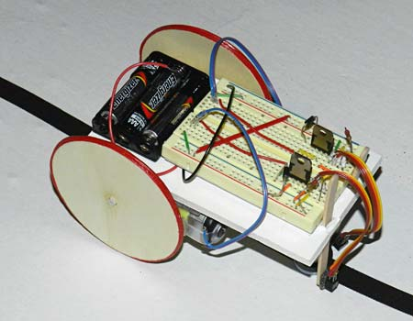
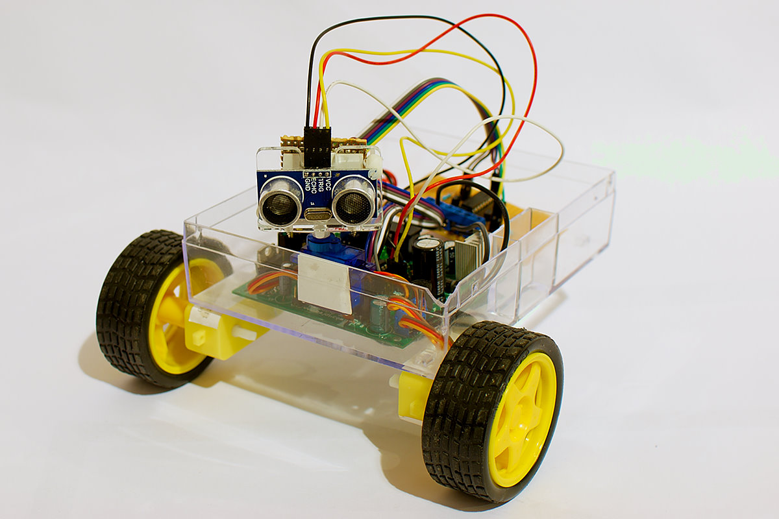
Notes:
*The HC-06 acts as a serial port through which you can send and receive data.
*So using a serial terminal or a Bluetooth customized application on your computer or phone, you can control and monitor your project.
*HC06 functions only as slave to a microcontroller

Slide 6
Line Following Robot

Slide 7
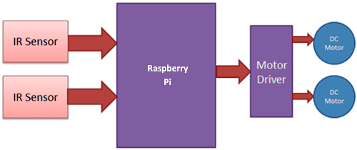
Infra Red Module

Slide 8
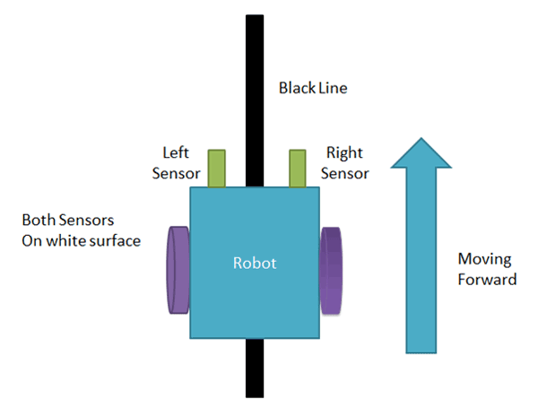

Slide 9
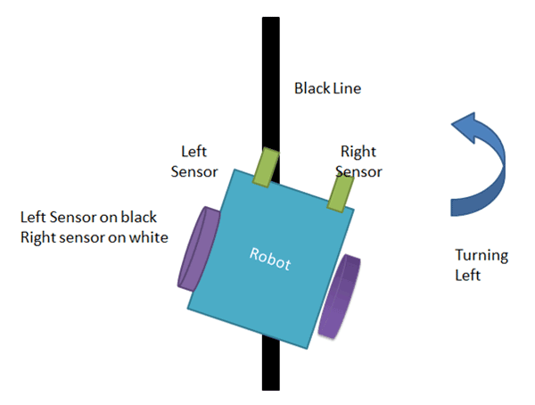

Slide 10
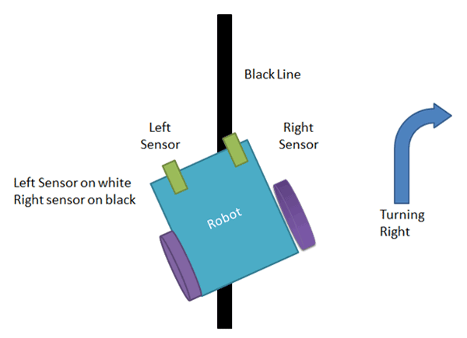

Slide 11
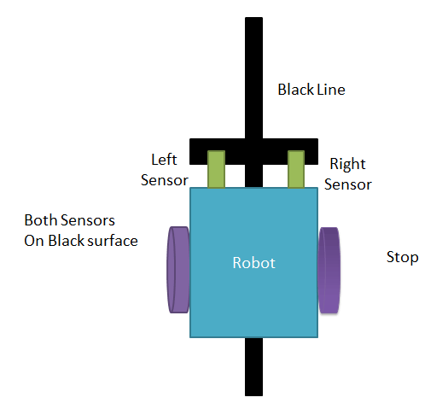

Slide 12
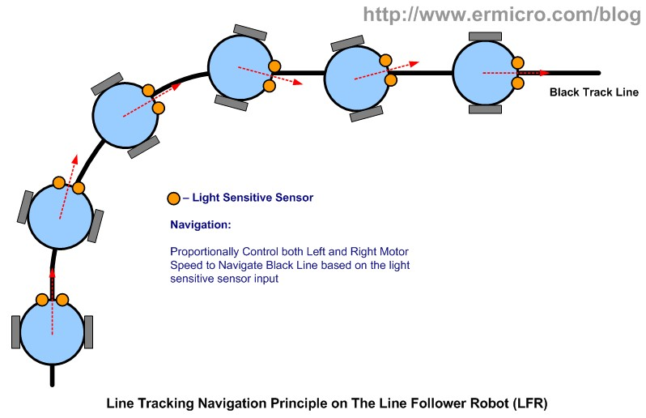

Slide 13
Components

Slide 14
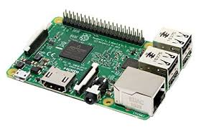
Raspberry Pi
1.2Ghz quad core CPU
1gb DDR2 RAM
4USB Ports
No Memory

Slide 15
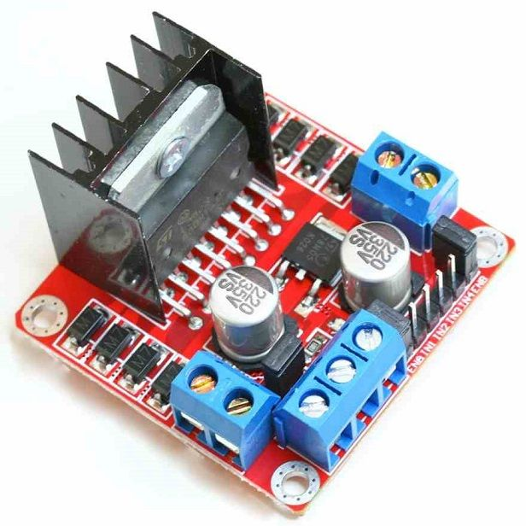
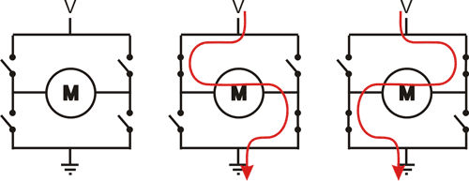
L298N Motor Driver
MOTOR A |  |  | MOTOR B |  |  | Outcomes
ENA | IN1 | IN2 | ENB | IN3 | IN4
0 | N/A | N/A | 0 | N/A | N/A | Motors are off
1 | 1 | 0 | 1 | 1 | 0 | Both motors move forwards
1 | 0 | 1 | 1 | 0 | 1 | Both motors move backwards
1 | 1 | 0 | 0 | 0 | 0 | Motor A moves forward (simulate left turn)
0 | 0 | 0 | 1 | 1 | 0 | Motor B moves forward (simulate right turn)
Notes:
Polylactic Acid (PLA)
Acrylonitrile butadiene styrene (ABS)

Slide 16
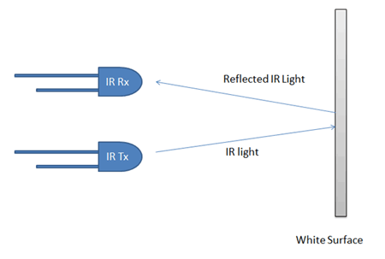
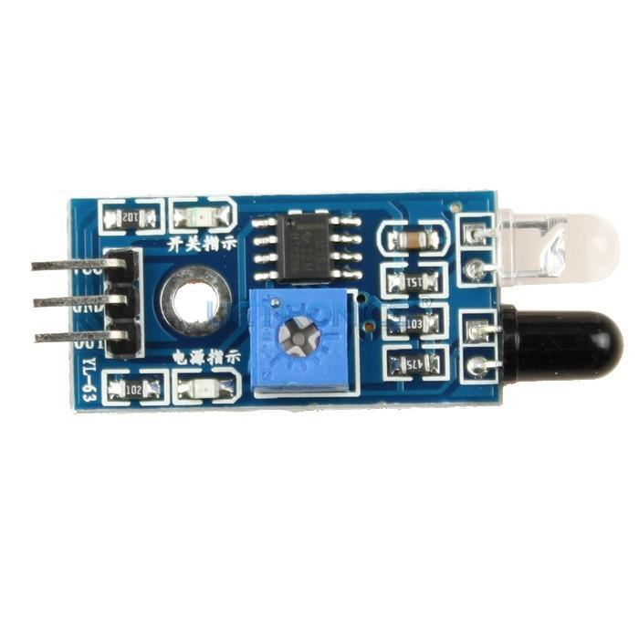
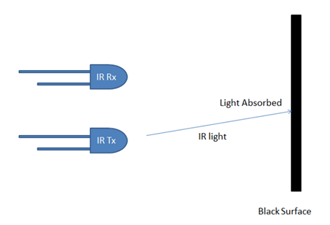
InfraRed Modules

Slide 17
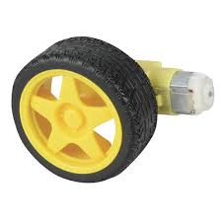
Geared DC Motors

Slide 18
Connect

Slide 19
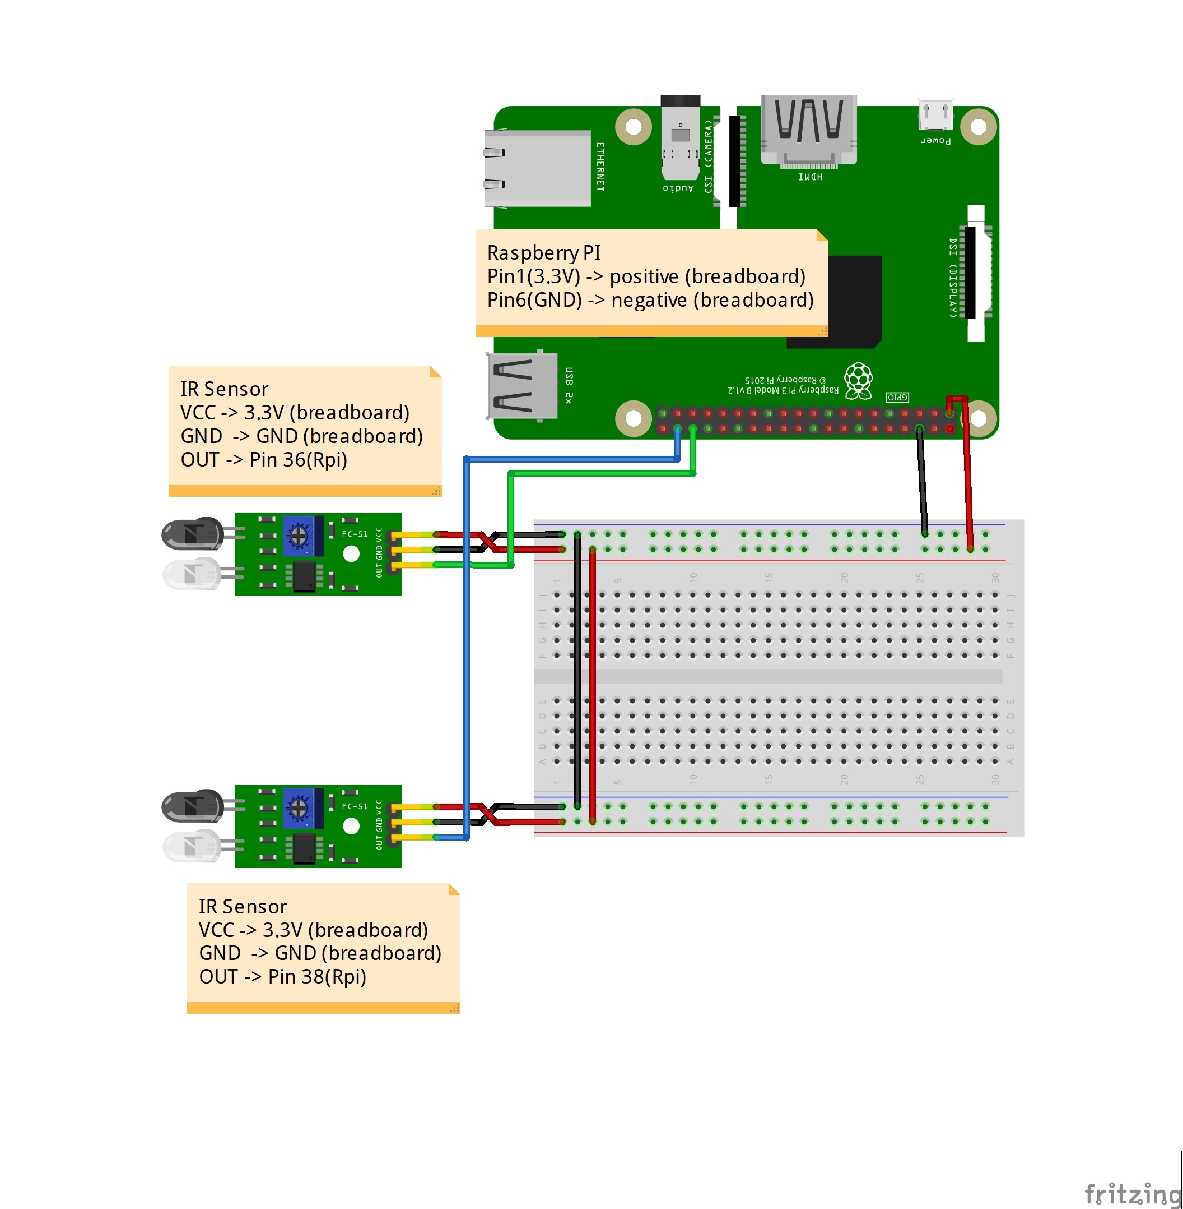

Slide 20
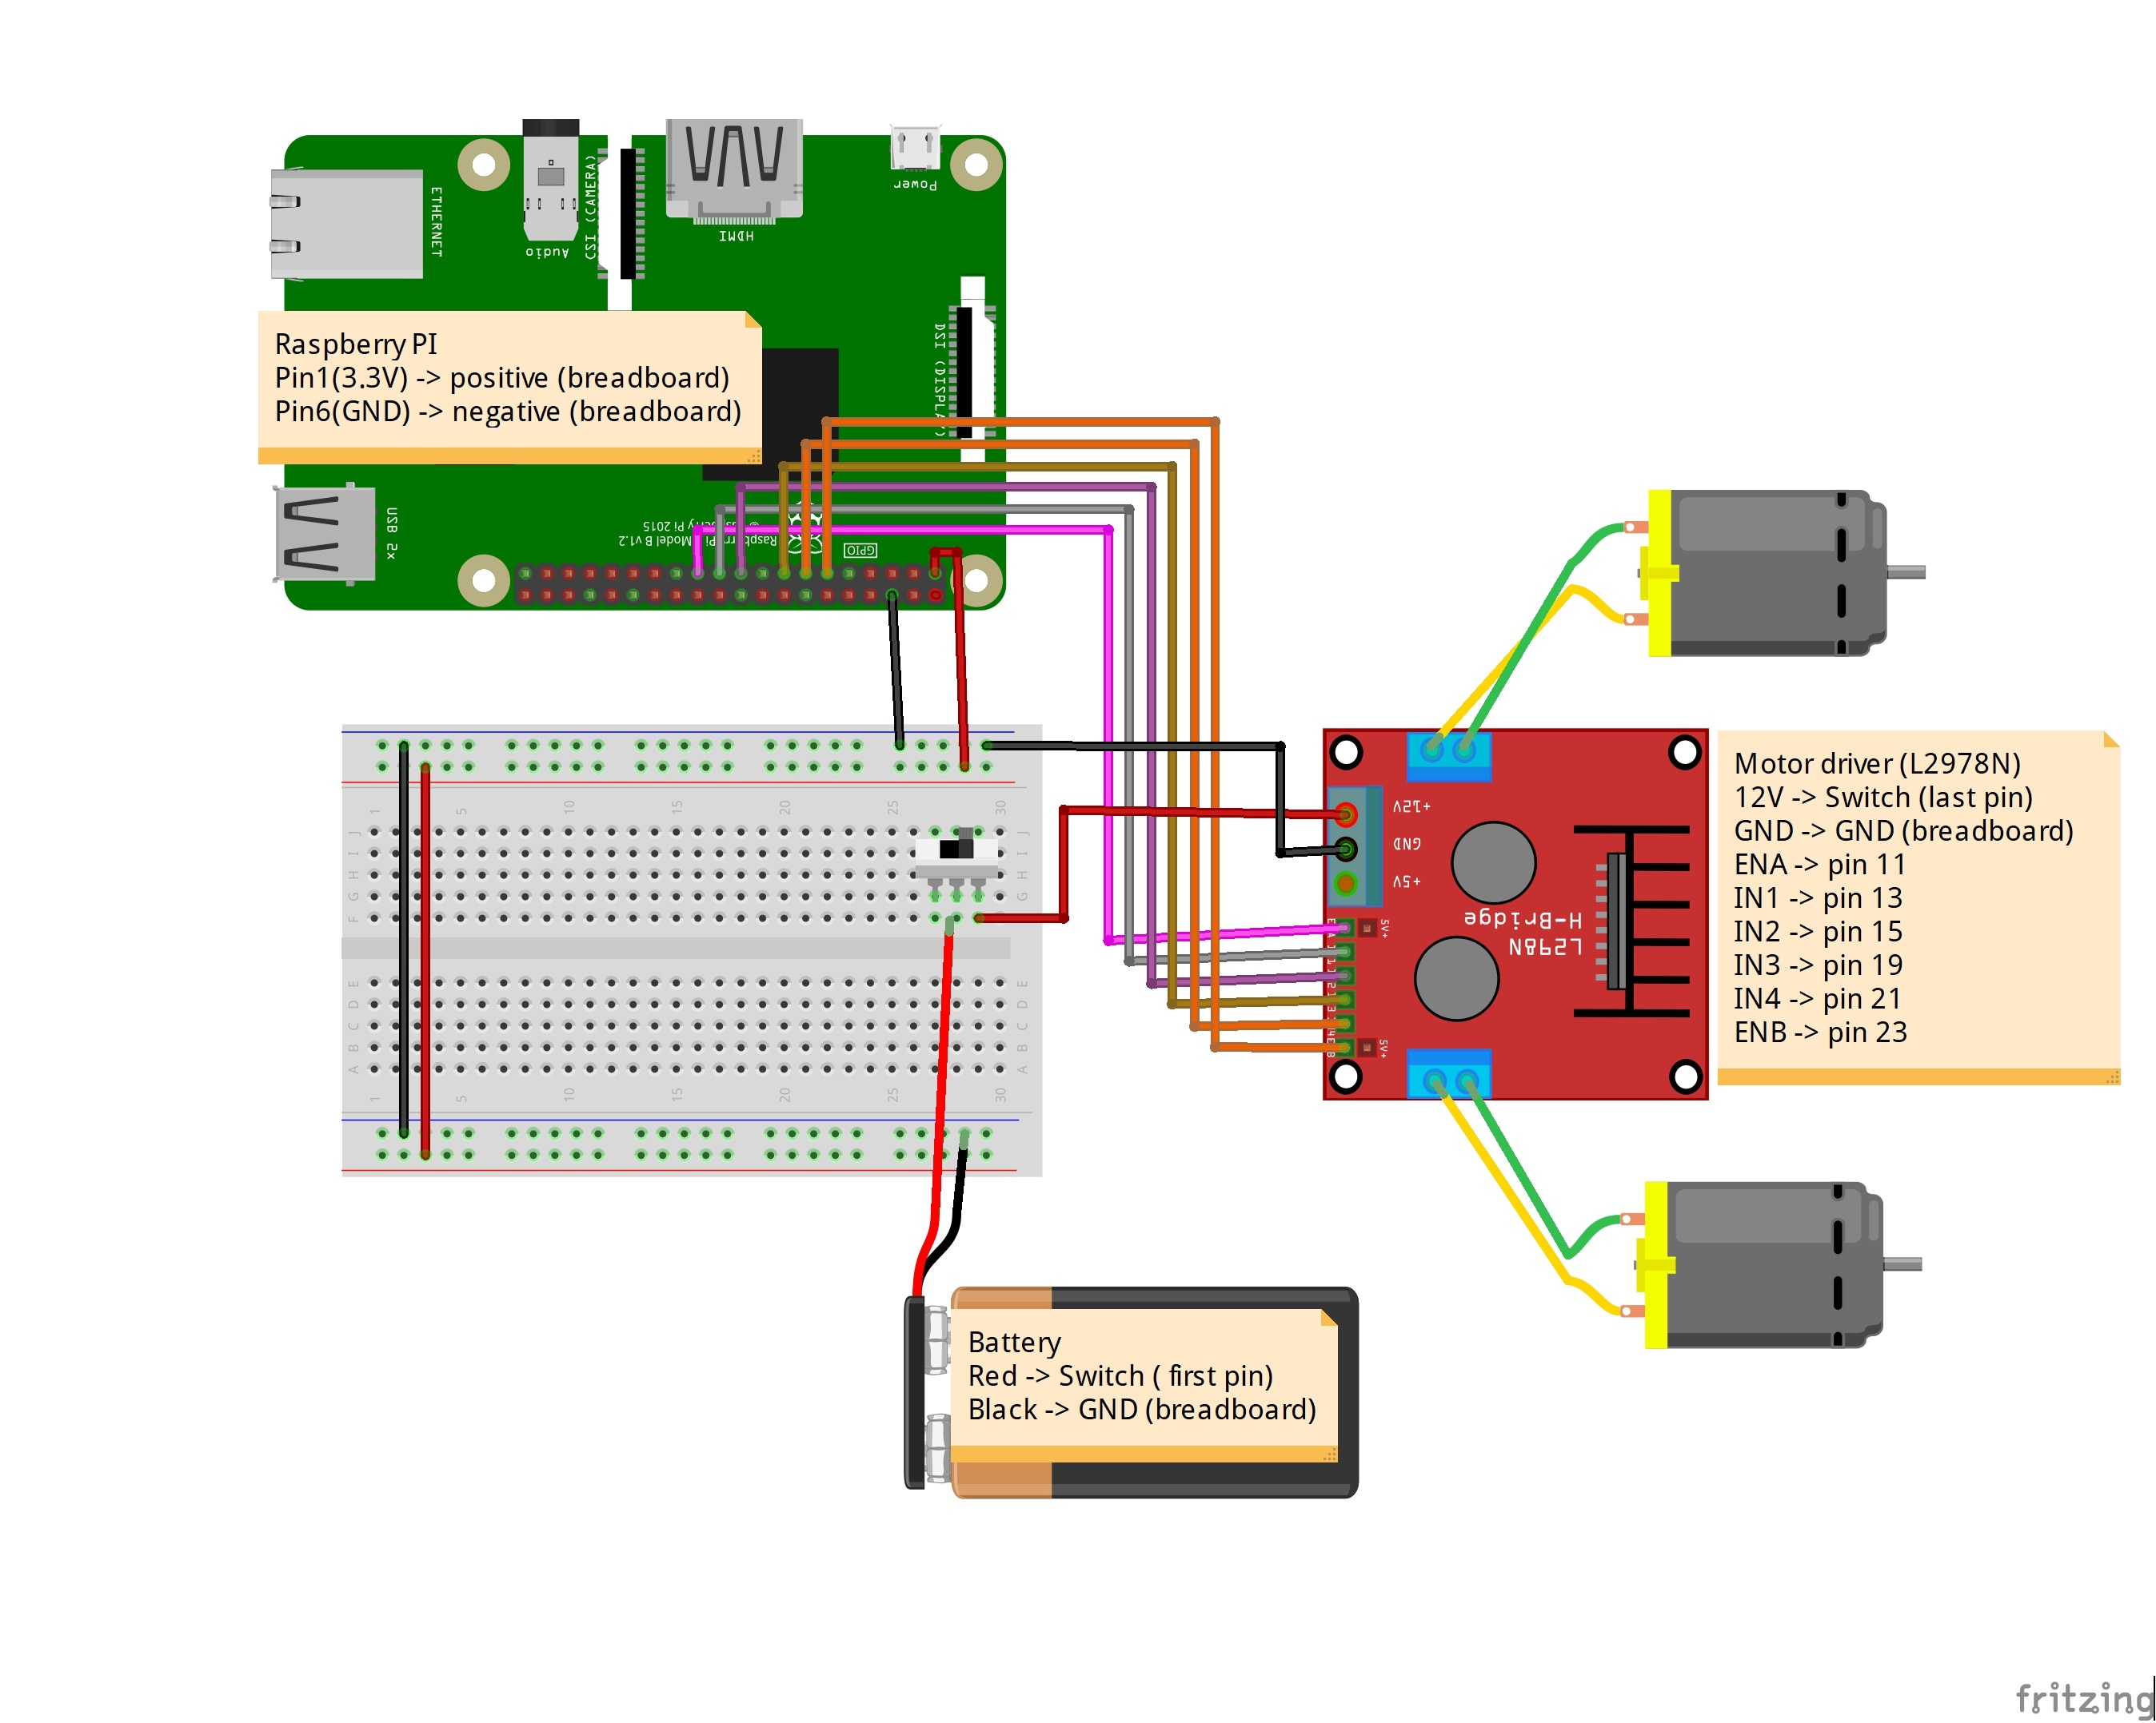

Slide 21
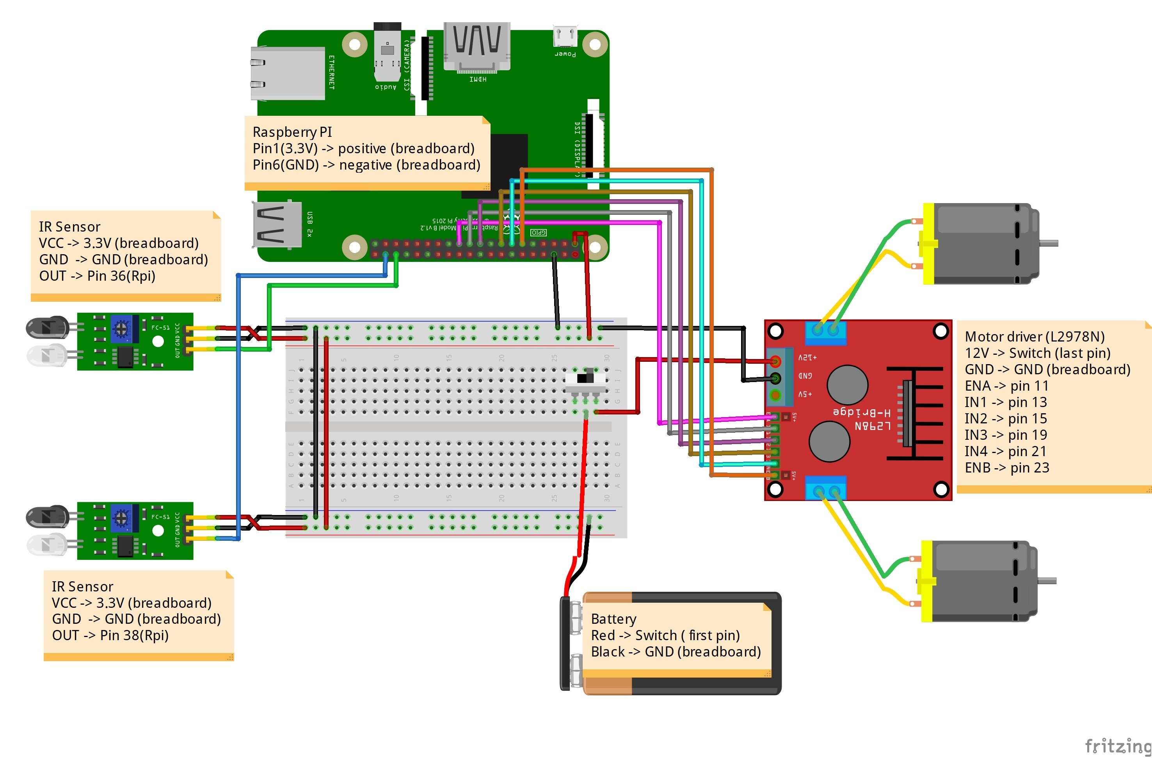

Slide 22
Code

Slide 23
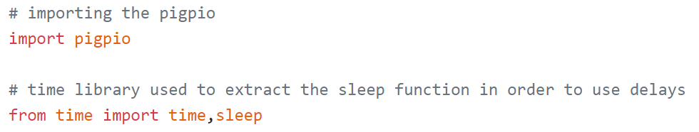

Slide 24
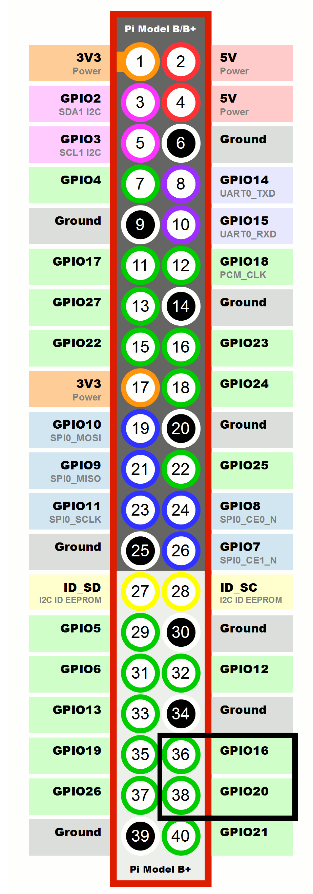
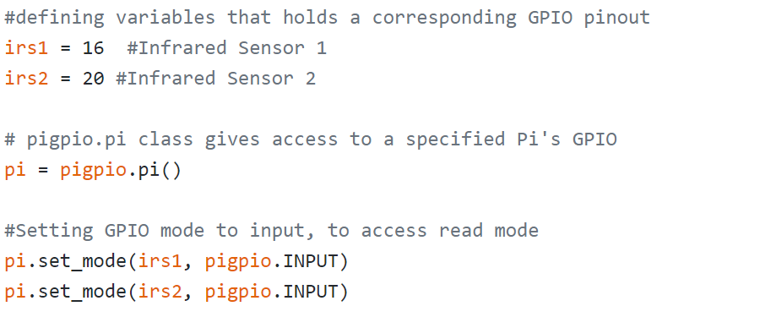

Slide 25
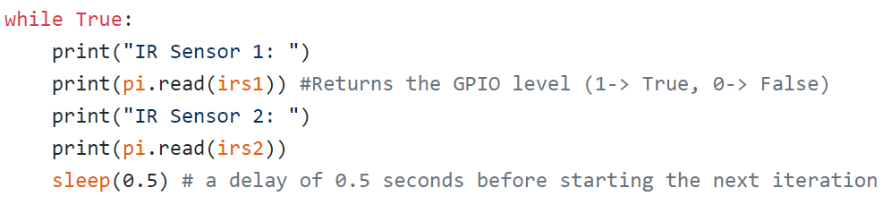

Slide 27
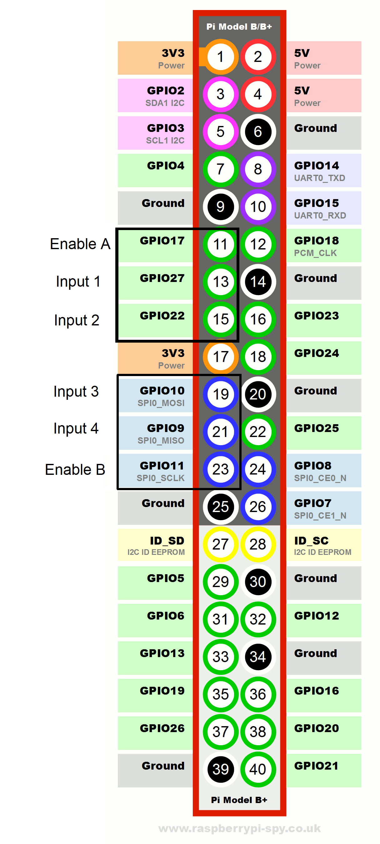
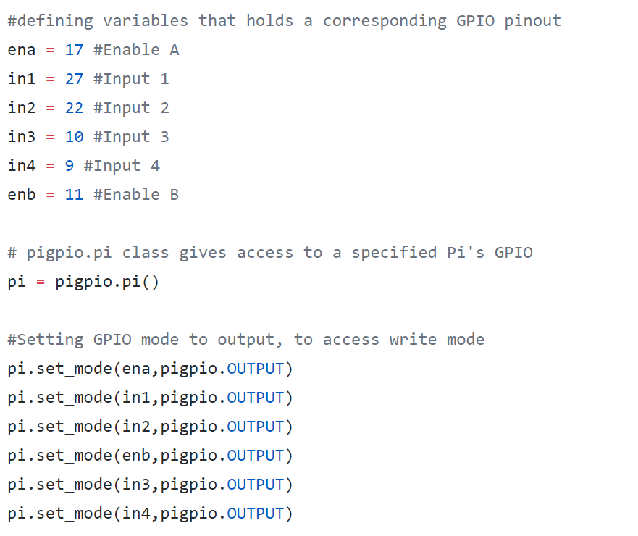

Slide 28
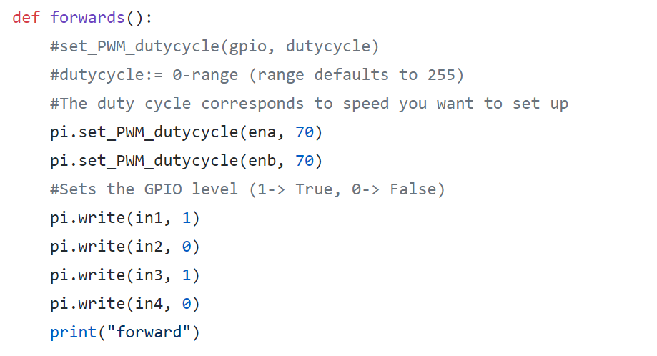
Python script – motor driver test
Defining functions for motors to move in a certain direction
MOTOR A |  |  | MOTOR B |  |  | Outcomes
ENA | IN1 | IN2 | ENB | IN3 | IN4
0 | N/A | N/A | 0 | N/A | N/A | Motors are off
1 | 1 | 0 | 1 | 1 | 0 | Both motors move forwards

Slide 29
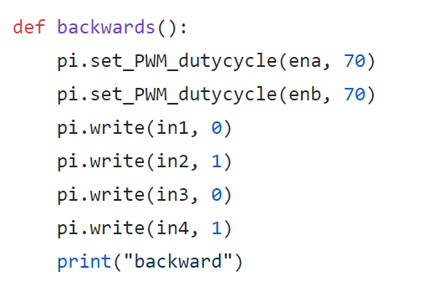
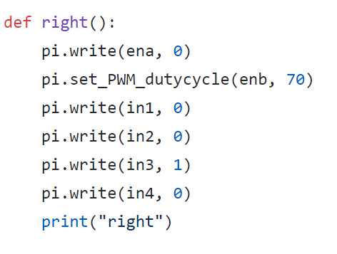
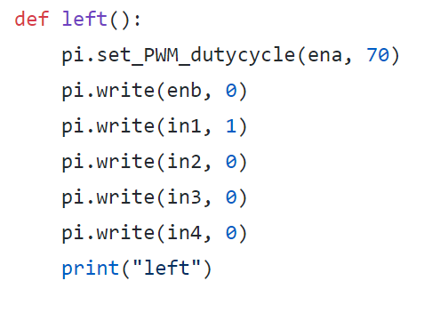
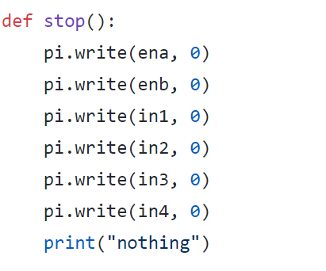
Python script – motor driver test

Slide 30
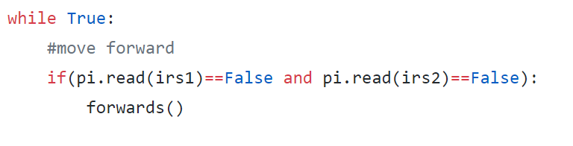
Python script – Line following test
IR 1 (left) | IR 2 (right) | driver response
0 | 0 | forward
Challenge: set the conditions for other responses
HINT:
IR 1 (left) | IR 2 (right) | driver response
1 | 0 | turn right
0 | 1 | turn left
1 | 1 | stop

Slide 31

THANK YOU

